Slide 1
WEATHER AND TEMPERATURE
NAME : 강동균(201995001)
김동욱(201995010)

Slide 2
목차
01
02
03
Data Collect & Stored
Tool & Programing Word
Visualization

Slide 3




Tool & Program Word

Slide 4




Data Collect & Stored
OpenWeatherMap
API Key
Data With JSON
Stored
In
Blob Storage

Slide 5
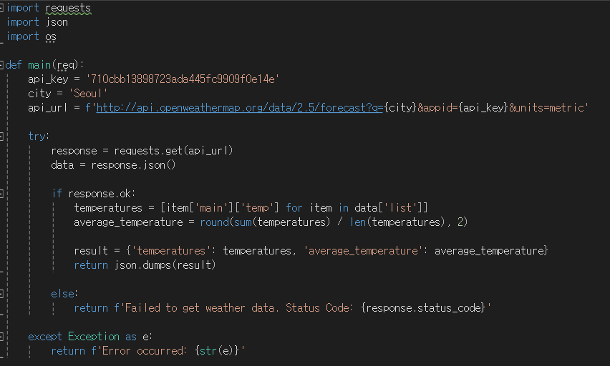

Visualization
Upload

Slide 6
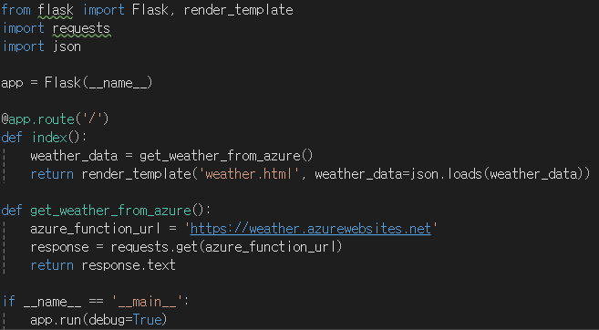
Visualization
Fetch Data
From Storage

Slide 7
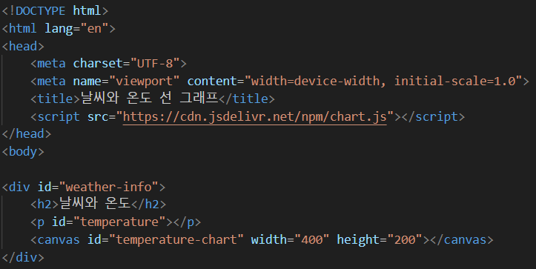
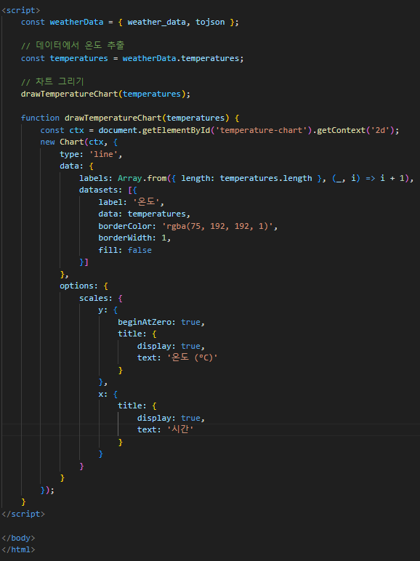
Visualization
HTML for UI

Slide 8
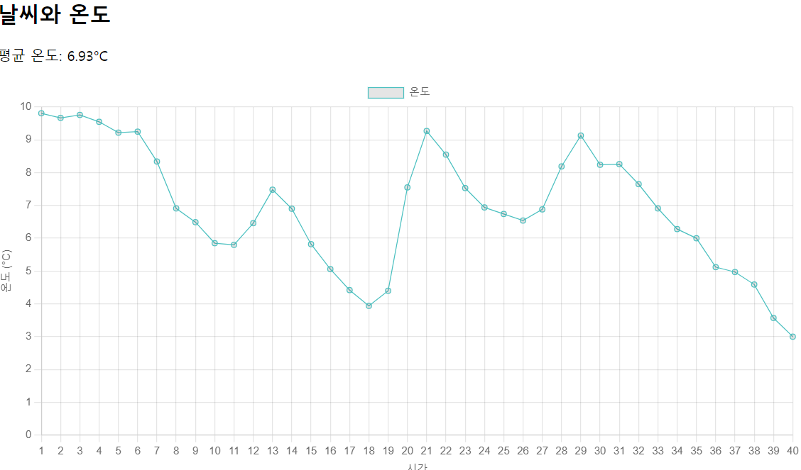
Visualization

Slide 9
THANK YOU!

Slide 10
SOOURCE : Namuwiki, Google Play, Wikipedia, Tstory, RevDeBug, Element61, Freepik, SKT Enterprise Git Hub : https://github.com/KDU327/Cloud.git

